Slide 1
Microsoft Azure IaaS
Matt Hester
Jeff Wagner
Notes:
(Introductions and set expectations that this presentation is designed to discuss the role of Azure as the cloud computing platform for a business’s digital transformation.)

Slide 2
Agenda
Compute
Network
Storage
Key Workloads

Slide 3
Some Azure Trivia …

Slide 4
During the Sochi Olympics how many simultaneous online users watched the USA/Canada Hockey Game via Azure?
2.1 Million

Slide 5
How many compliancy offerings does Azure offer?
48
64
How many compliancy offerings does AWS offer?

Slide 6






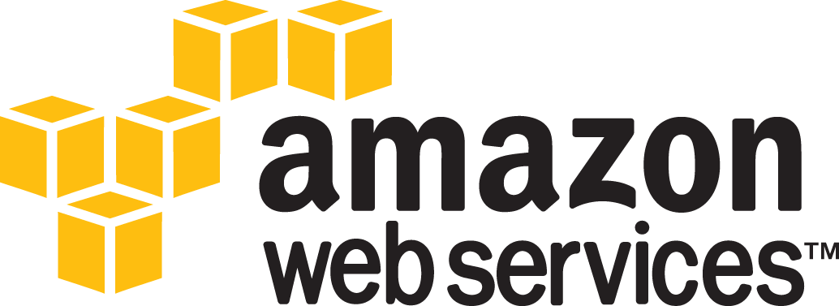
Azure compliance Largest compliance portfolio in the industry
Breadth: Total number of offerings
Depth: Number of customer facing services

Slide 7
How many HD Blu Ray DVD’s could travel across the Azure network every second?
7000 (that is 72+ Tb per second backbone)
And FYI that is 25% more bandwidth than AWS

Slide 8
How many times could the Microsoft Fiber Optic Network that connect our Azure datacenters stretch to the moon and back?
3
We now have over 1.6 M miles of fiber between our Azure datacenters

Slide 9
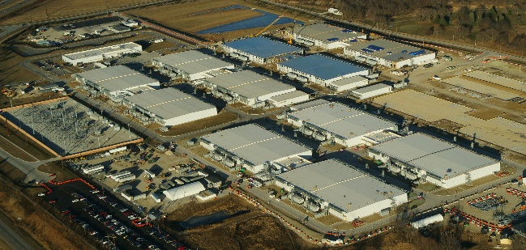
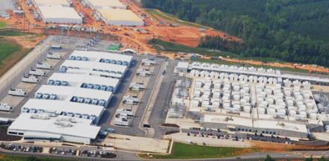
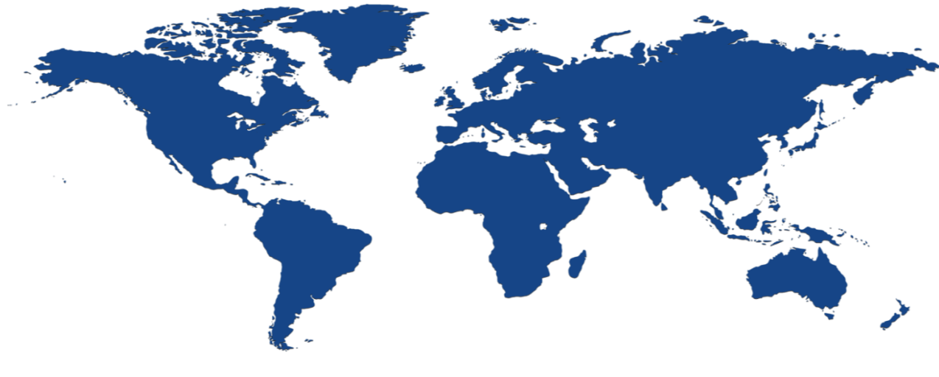
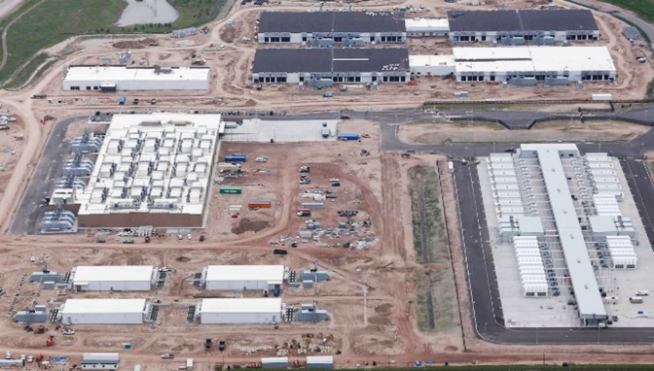
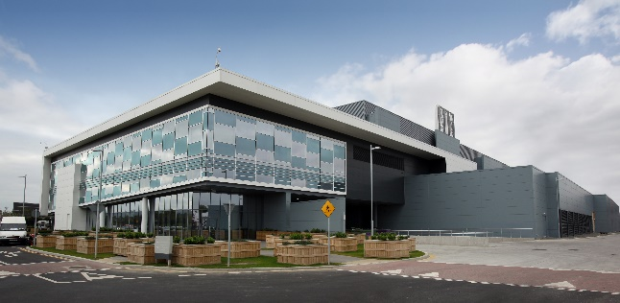

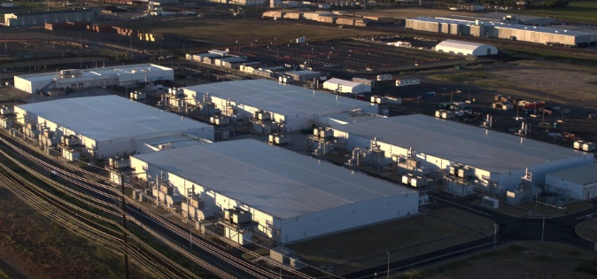
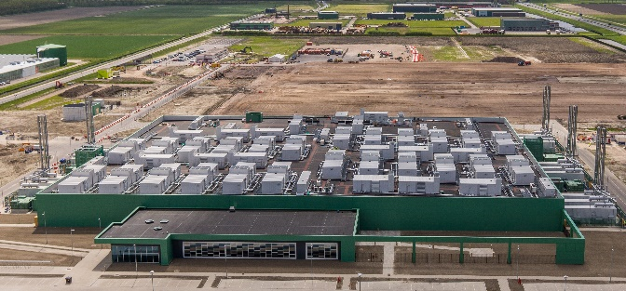
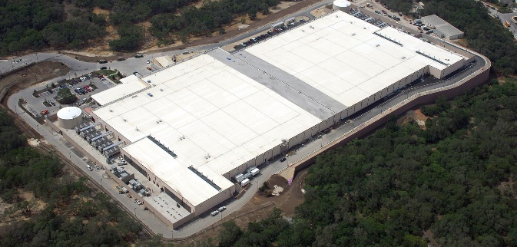
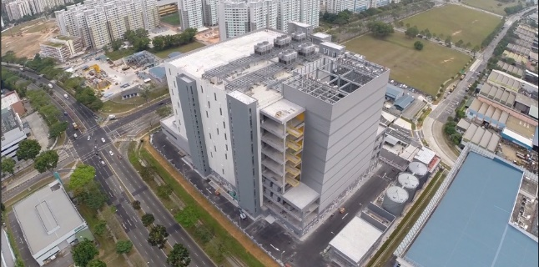


Microsoft infrastructure investments
40 Cloud regions worldwide
United Kingdom South
North Central US
United Kingdom West
West Europe
West US 2
Central US
Canada Central
Germany Northeast²
US Gov
Canada East
North Europe
Korea Central³
France³
Germany Central²
Korea South³
West US
East US
France³
China West¹
Japan East
US DoD West³
Japan West
West Central US
East US 2
China East¹
US Gov
West India
South Central US
US DoD East³
East Asia
Central India
South India
100+ datacenters
and
Millions of Servers
Southeast Asia
Brazil South
Australia East
Australia Southeast
Global datacenters
Sovereign datacenters

Slide 10
In general, do we cool our Azure Data Centers?
No!
http://www.datacenterknowledge.com/archives/2016/09/27/latest-microsoft-data-center-design-gets-close-to-unity-pue
Notes:
Rio 2016 Olympics largest live cloud-delivered event in history
Sochi Olympics USA/Canada Hockey largest live cloud-delivered event
2.1 Million simultaneous users

Slide 11
What percentage of new workloads in Azure are Linux?
50+%
30% of the workloads run Linux today, and growing 2x compared to Windows
Notes:
Rio 2016 Olympics largest live cloud-delivered event in history
Sochi Olympics USA/Canada Hockey largest live cloud-delivered event
2.1 Million simultaneous users

Slide 12

Azure + Open Source Momentum
Azure is a strong platform for Open Source
1 in 3 VMs on Azure are Linux
Linux VMs are growing at ~2 times Windows VMs today
~60% of 3rd party Azure Marketplace images are OSS
Majority of the VM’s in Azure China and Germany are Linux
>50% of all Azure consumption will be driven by Linux/OSS….

Slide 13
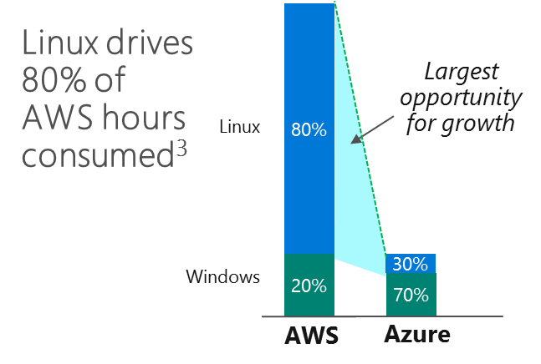


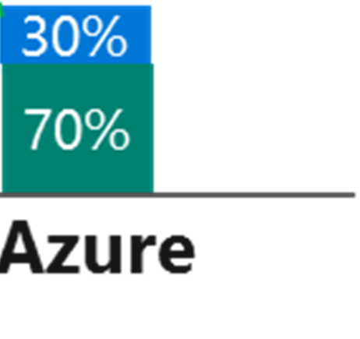
Our competitive reality…
Impressive, huh?!
1 Source: Forrester report titled “Open Source Powers Enterprise Digital Transformation”; 2 Source: The Arnold Group Report, FY15Q2 & MPF; 3 Source: FY16 AWS Cloud Usage Insights - C+E Marketing

Slide 14



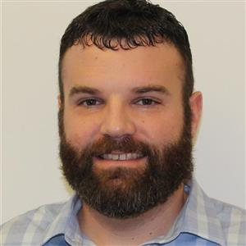



Open Source on Azure: V-Team Members
Peter Laudati
Ryan McIntyre
Manoj Vasudevan
Keith Mayer
Tommy Falgout
Tim Walton
Ryan Coffman
“Bringing combined Open Source industry experience to Microsoft Azure and our key Partners”.
Notes:
Key Talking Points
The Open Source V-Team in OCP is a comprised of a team of industry veterans with deep Open Source skills around application development, data platform, operating system and cloud infrastructure and DevOps.
Feel free to reach out to us at “ocpopen@microsoft.com” if we can assist with positioning or accelerating Open Source opportunities with your partners.

Slide 15
Cloud Computing Models
On-Premises
( Private Cloud )
Infrastructure
( as a Service )
Platform
( as a Service )
Software
( as a Service )
You Manage
You Manage
Data & Access
You Provision & Manage
Data & Access
Data & Access
Data & Access
You Provision & Manage
Applications
Applications
Applications
Applications
Provisioned & Managed by Vendor
Runtime
Runtime
Runtime
Provisioned & Managed by Vendor
Runtime
Operating System
Operating System
Operating System
Operating System
Virtual Machine
Virtual Machine
Virtual Machine
Virtual Machine
Physical Fabric Managed by Vendor
Compute
Microsoft
Provisions
Compute
Compute
Compute
Networking
Networking
Networking
Networking
Storage
Storage
Storage
Storage
Host
Develop
Consume
Notes:
(Adjust timing to Audience)
Slide Objective: Explain the commonly accepted cloud computing models (IaaS, PaaS, and SaaS) in terms of an IT Pro’s responsibilities.
Key Talking Points:
When considering these cloud computing models, skilled IT Pros are needed to manage the components of each model that are unique to an organization:
(CLICK) Infrastructure as a Service: While the cloud vendor manages the physical hardware fabric for raw compute, networking and storage capacity, (CLICK) IT Pros provision IaaS for their organizational needs and (CLICK) continue to manage each provisioned virtual machine in a manner that is very similar to on-premises workloads.
(CLICK) Platform as a Service: In PaaS, the cloud platform vendor provisions and manages a consistent runtime environment upon which applications can be developed. (CLICK) IT Pros are needed in deploying and monitoring these applications, as well as managing access and protection of data.
(CLICK) Software as a Service: In SaaS, an organization is consuming an entire packaged application that is being delivered via the cloud. (CLICK) IT Pros are needed to manage access to these applications and the underlying data.
By choosing the best cloud computing model for each application need, depending on whether your organization needs to host, develop or consume an application, IT Pros can gain significant time-savings when managing applications that can then be applied to time investments in new strategic projects for an organization.

Slide 16
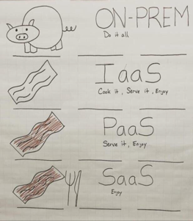

Slide 17




Azure Infrastructure Breadth
Over 100 services, continuous evolution
Data Factory
Traffic manager
Analytics
Event Hubs
SQL Database
SQL Data Warehouse
DocumentDB
Search
ExpressRoute
Machine Learning
HDInsight
Virtual Machines
Cloud Services
Batch
Remote Desktop
Storage
StorSimple
Redis Cache
Virtual network
Azure AD
Multi-Factor
Backup
Site Recovery
Service bus
BizTalk
Management
Automation
Op Insights
DNS
Web Apps
Mobile Apps
Notification Hubs
API Management
Mobile Engagement
App Service
API Apps
Logic Apps
Key Vault
App Gateway
VS Online
VS App Insights
Media Service
Media Intelligence
Media Encoding
Media Protection
Media Player
Media Streaming
CDN
VPN Gateway

Slide 18
Azure Virtual Machines

Slide 19
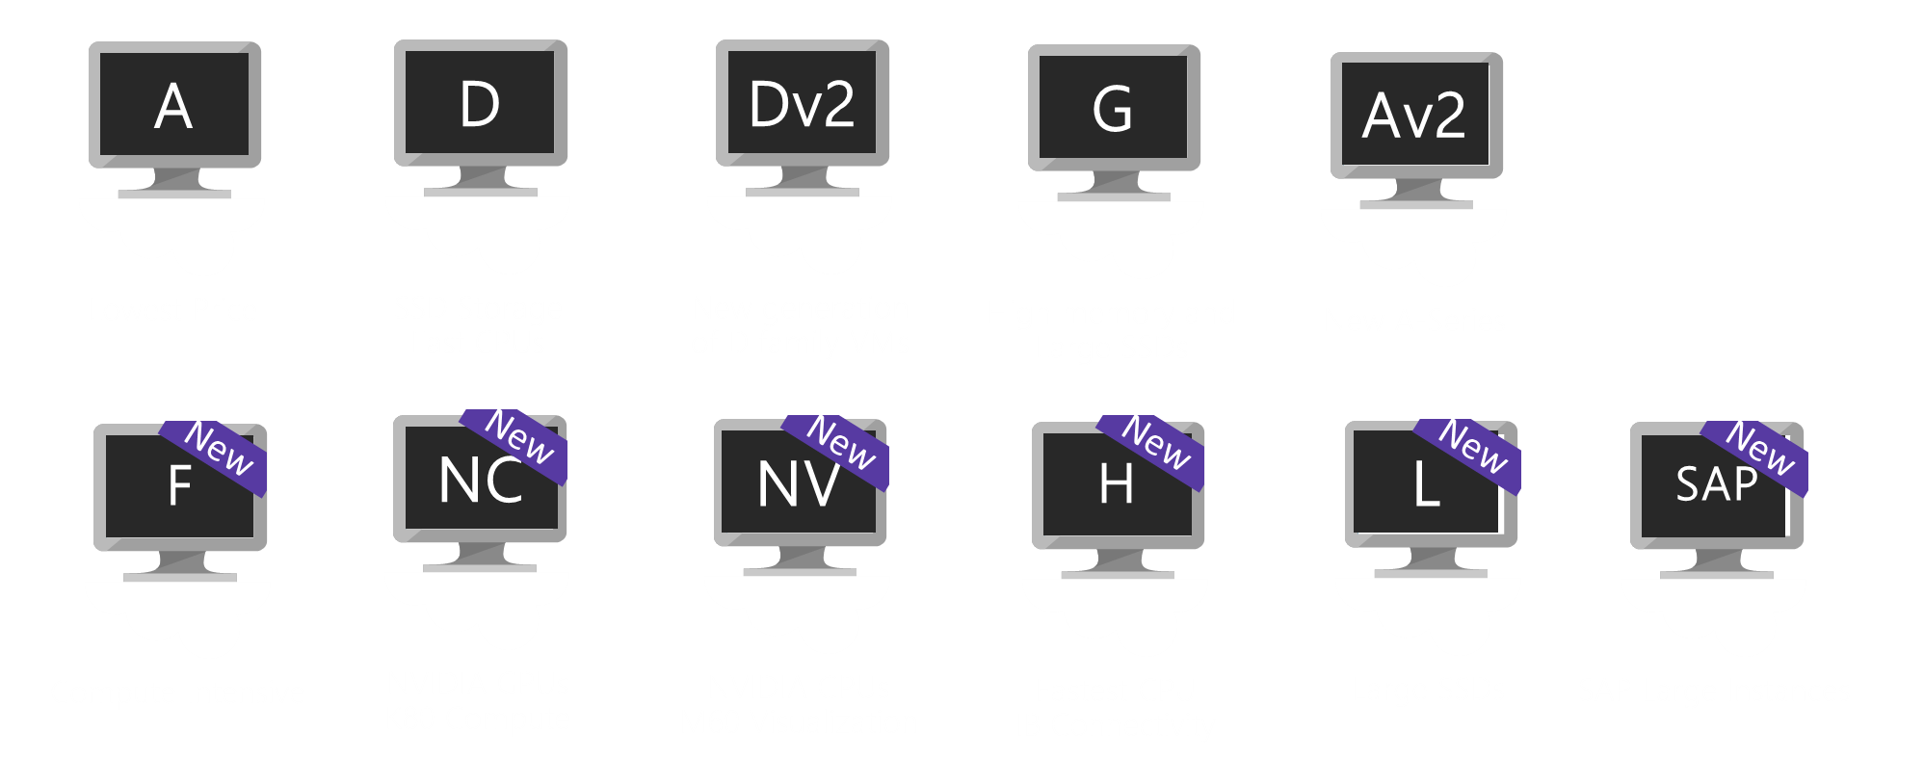
Hardware Innovation
Soon
Soon
Soon
Soon
Soon
M
Dv3
Ev3
ND
NCv2
Lv2
B
Fv2
Extremely
Large Memory
New generation of D family
High memory
Deep Learning
NVIDIA P40s
New gen of NC
NVIDIA P100s
AMD-based
Sizes
Burstable
Compute

Slide 20
IaaS Virtual Machines
Windows and Linux Virtual Machines provides on-demand, high-scale, secure, virtualized infrastructure using Windows Server
Come in different “Families” or “series” used to categorize their general function
For most SI partners, this is their cash cow
Use automation spin up/spin down as needed
Default pricing is on 24h x 31d, or 744 hours

Slide 21
Managed Disks

Slide 22
Using Managed Disks for HA
Managed Disks replace the need to have separate storage accounts for each VM
No longer have storage account limits (such as 20,000 IOPS/account)
Better reliability for Availability Sets
Better security by being able to utilize RBAC to assign specific permissions
Two types – Standard and Premium
Standard disks are billed for the number of transactions
No cost for transactions for premium disks

Slide 23


Unmanaged Disks
Physical View
Logical View
MyResourceGroup
Availability Set
Availability Set
Compute
FD0
Compute
FD1
Compute
FD0
Compute
FD1
DiskUrl:
http://mydisks0../disk0.vhd
DiskUrl:
http://mydisk1.../disk1.vhd
Storage FD0
Account Name: mydisks0
Account Name: mydisks1

Slide 24
Managed Disks
Physical View
Logical View
MyResourceGroup
Availability Set
Availability Set
Compute
FD0
Compute
FD1
Compute
FD0
Compute
FD1
osDisk.name:
myDisk0
osDisk.name:
myDisk1
Storage FD0
Storage FD1
myDisk0
myDisk1
https://azure.microsoft.com/en-us/blog/announcing-general-availability-of-managed-disks-and-larger-scale-sets/

Slide 25
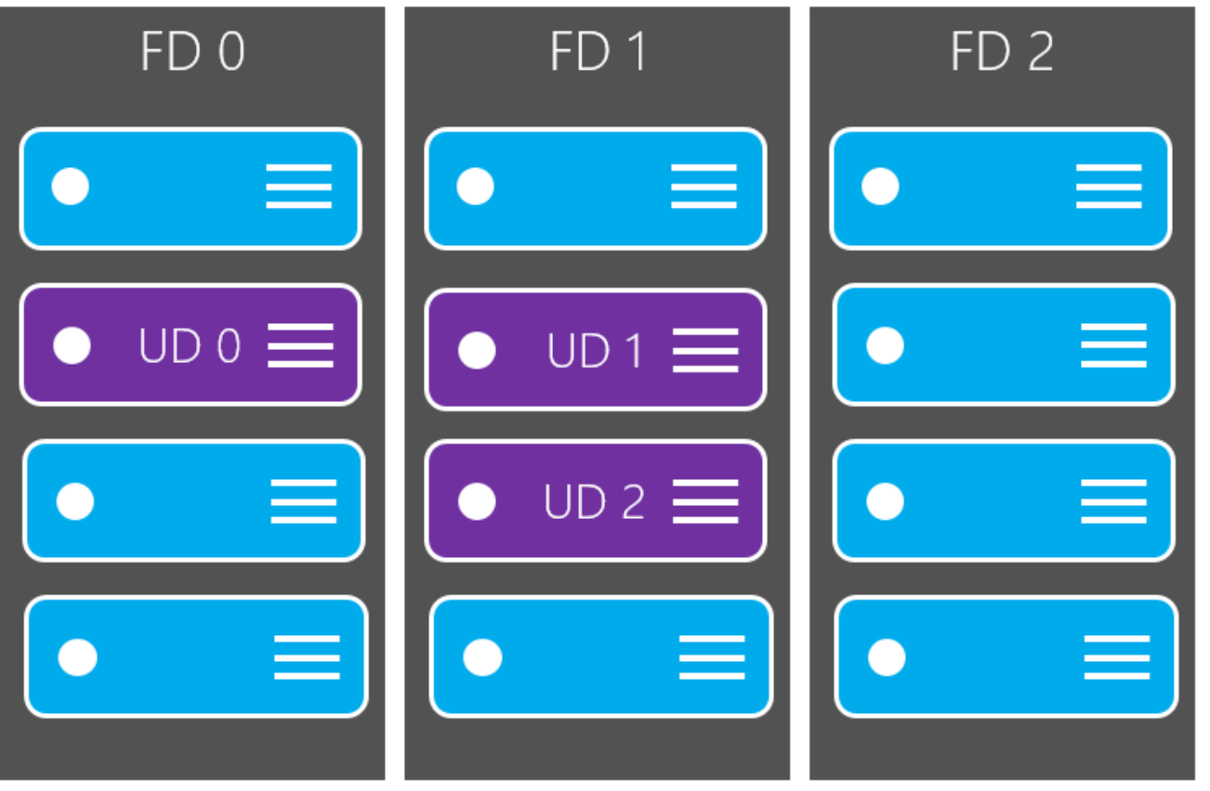
Availability Set

Slide 26
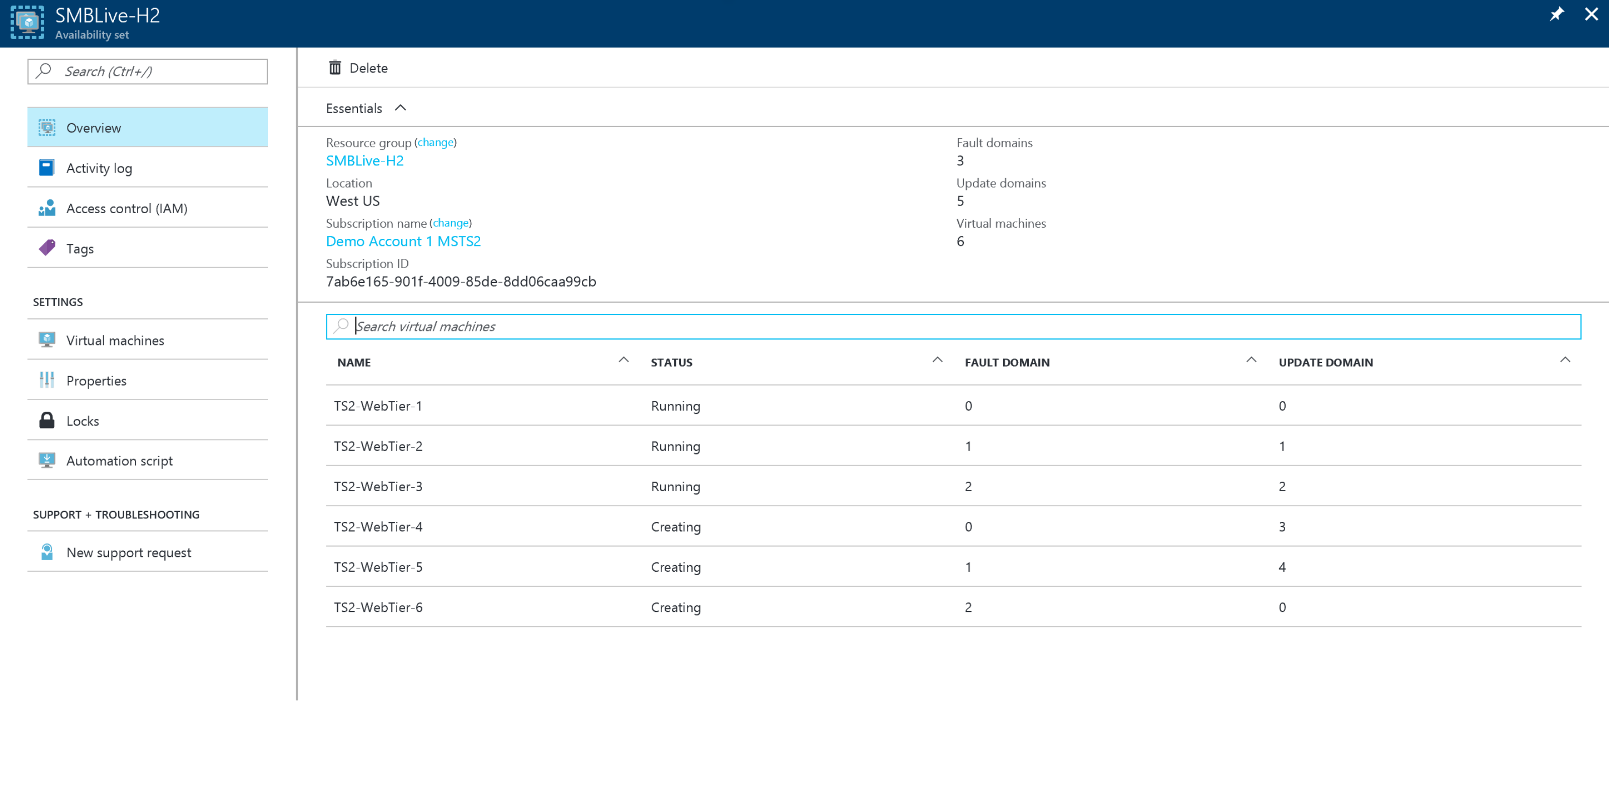
Availability Set

Slide 27
Options for Highly Available VMs
Option 1 (Good $) – Using premium managed disks to get a single VM SLA
Minimum VM size is D1
Must use premium managed disk
Option 2 (Better $$)– Using availability sets
Can use lower tier VMs (A vs D)
Can use standard managed disk
Transactions costs will be calculated for standard disk types
Option 3 (Best $$$)– Using premium managed disk VMs in an availability set
Ultimate level of protection
No transaction costs on the managed disks

Slide 28
Let’s Take A Look
http://52.175.222.85/

Slide 29
Azure Networking

Slide 30
The big (network) picture
Virtual network
“Bring your own network”
Segment with subnets and network security groups
Control traffic flow with user defined routes
Azure
virtual network
Users
Internet
Front-end access
Dynamic/reserved public IP addresses
Direct VM access, ACLs for security
Load balancing
DNS services: hosting, traffic management
DDoS protection
Backend connectivity
ExpressRoute VPN Gateways
Backend connectivity
Point-to-site for dev/test
VPN Gateways for secure site-to-site connectivity
ExpressRoute for private enterprise grade connectivity

Slide 31



Connectivity Options to Azure
Cloud
Customer
Segment and workloads
Consumers
Access over public IP
DNS resolution
Connect from anywhere
Internet Connectivity
Developers
POC Efforts
Small scale deployments
Connect from anywhere
Secure point-to-site connectivity
SMB, Enterprises
Connect to Azure compute
Secure site-to-site
VPN connectivity
SMB & Enterprises
Connect to Microsoft services
Mission critical workloads
ExpressRoute private connectivity

Slide 32
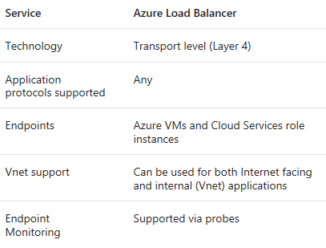
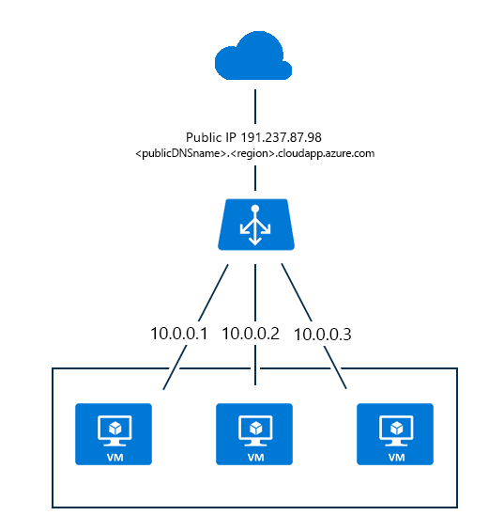
Azure Load Balancer

Slide 33
Azure Storage

Slide 34
Key Concepts
Key Characteristics
Scalable and Elastic
Massively scalable – will grow or shrink to meet your demand
Pay for what you use
Auto-partitioning system that automatically load-balances your data based on traffic
Two Tiers
Premium
High-performance, low latency for I/O-intensive workloads
SSD
Standard Storage
HDD

Slide 35
Four Services
Blob Storage (large amounts of unstructured object data)
Block blobs are optimized for streaming and storing cloud objects, and are a good choice for storing documents, media files, backups etc.
Append blobs are similar to block blobs, but are optimized for append operations. An append blob can be updated only by adding a new block to the end. Append blobs are a good choice for scenarios such as logging, where new data needs to be written only to the end of the blob.
Page blobs are optimized for representing IaaS disks and supporting random writes, and may be up to 1 TB in size. An Azure virtual machine network attached IaaS disk is a VHD stored as a page blob.
Table Storage
Table storage offers highly available, massively scalable storage, so that your application can automatically scale to meet user demand.

Slide 36
Four Services
Queue Storage
Provides a reliable messaging solution for asynchronous communication between application components, in the cloud, on the desktop, on an on-premises server, or on a mobile device.
File Storage
Cloud-based SMB file shares
You can map a drive only for applications running in Azure virtual machines or cloud services
On-prem solutions can connect to Azure Files via REST API

Slide 37
Key IaaS Workloads

Slide 38
Business Continuity and High Availability with Microsoft Azure

Slide 39
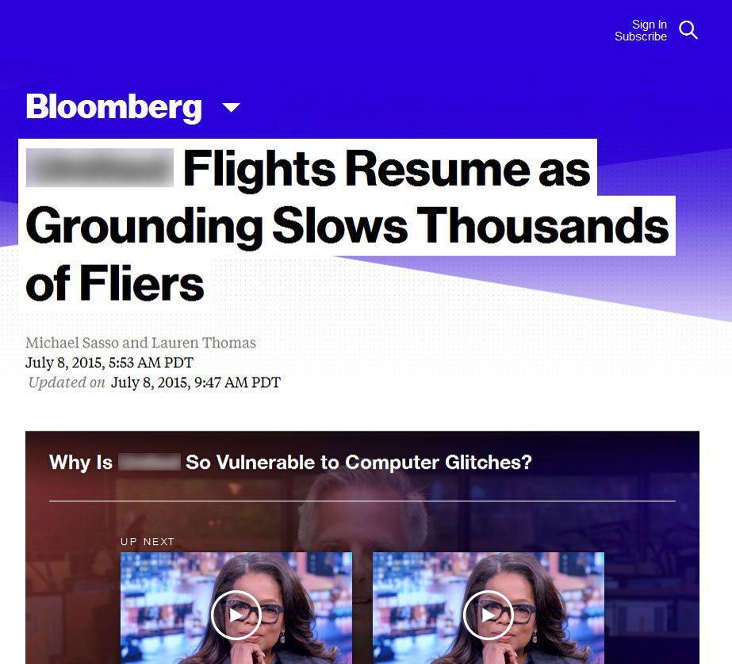

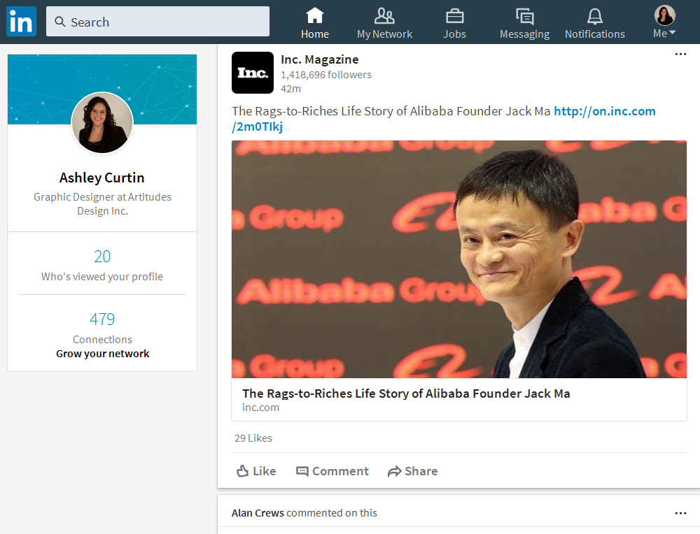
The impact of an outage on your digital business
Business continuity and data protection are critical
Impact of the outage itself
Impact to your brand
Impact to your IT career
Notes:
-In this world of digital transformation – every business is a digital business and the importance of technology as a driver for business value has never been greater and it goes along with this that when an outage occurs the impact has also never been greater.
-There are the direct costs often measured in lost sales during the time period of the outage. Certainly last year wasn’t great for the aviation industry and many of us experienced this challenge directly. While aviation is highly visible it certainly wasn’t the only industry affected. Another example recently was the githab outage which was caused by human error – an admin executed rm –rf which deletes all your files – and as such is the finest Linux compression known with no available decompression command.
-Beyond the direct costs are the indirect costs such as the impact to your overall brand which can be both greater and further reaching.
-In IT we sign up for the charter of keeping the lights on and unfortunately its our roles that often bear the brunt of these challenges when things go wrong so we need to be plan-ful to ensure they don’t.

Slide 40
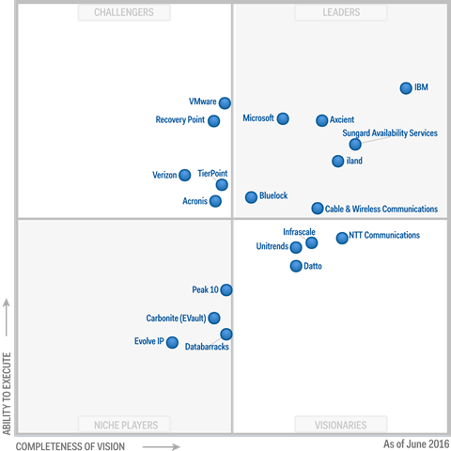
Gartner Magic Quadrant Leader
Notes:
Azure Site Recovery is positioned by Gartner as a Magic Quadrant Leader
Source: Gartner’s Magic Quadrant for Disaster Recovery as a Service (2016) https://www.gartner.com/doc/reprints?ct=160617&id=1-39NNEX2&st=sb

Slide 41
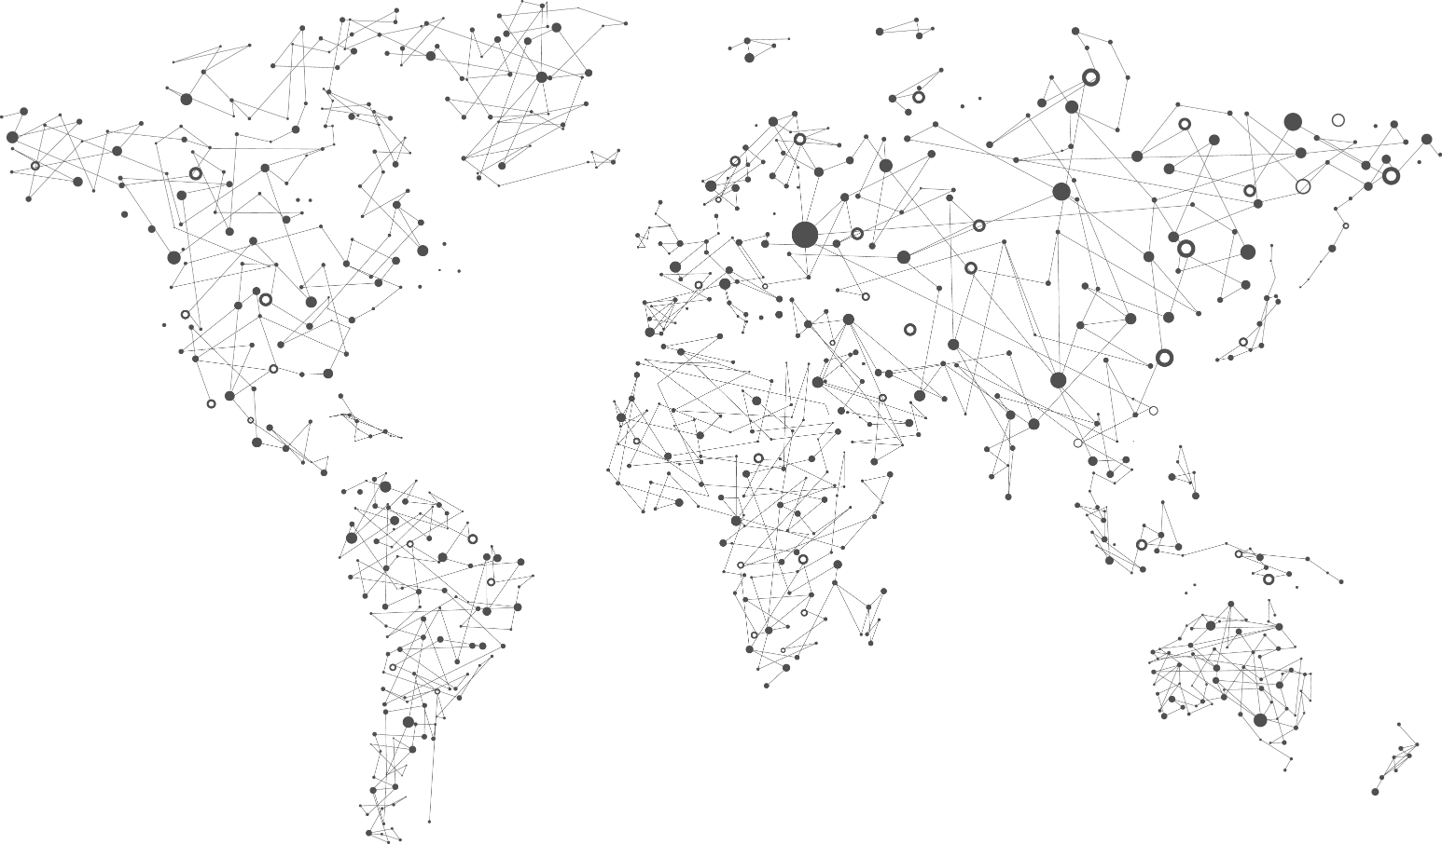










10
In-country disaster recovery

Slide 42
Business continuity strategy
You need all three
Primary site
Primary site
Secondary site
Original
Backup
DATA
DATA
High availability
Disaster recovery
Backup
When your applications have a catastrophic failure, run a second instance
When your applications have a catastrophic failure, run them in Azure or a secondary datacenter
When your data is corrupted, deleted or lost you can restore it

Slide 43


THANK YOU

